Slide 1
DENSITY OF STATES MEASUREMENTS IN A P-I-N SOLAR CELL
Richard S. Crandall and Qi Wang
National Renewable Energy Laboratory
25th PVSC; May 13-17, 1996; Washington, D.C.

Slide 2



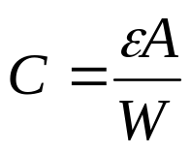
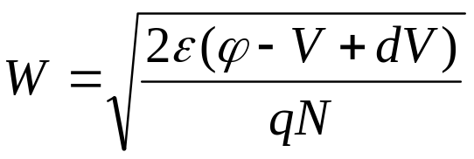
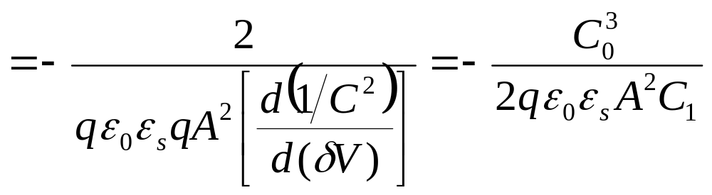
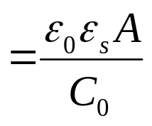
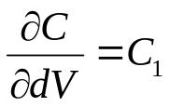
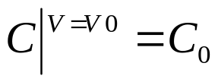
N_{DL} from C-V Curve
For N_{DL} (缺陷密度)
量測條件: DC constant, AC amplitude variation
當
因
，
C₀³
N_{DL}
C₁
C
d
C₀
C₀
slope = C₁
，
AC level

Slide 3
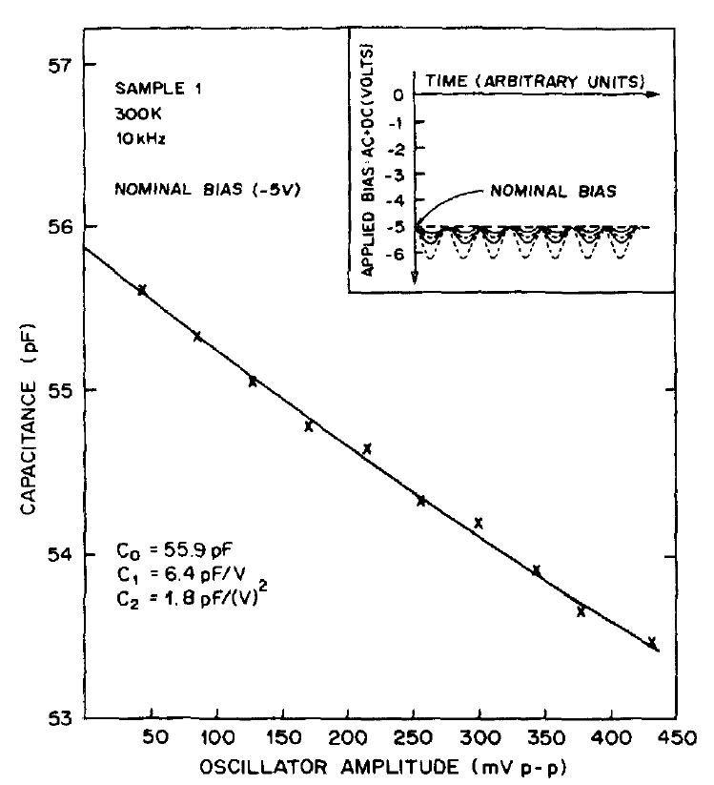
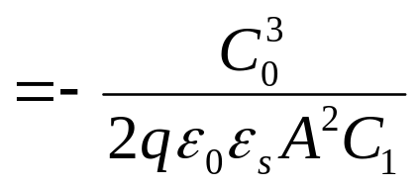
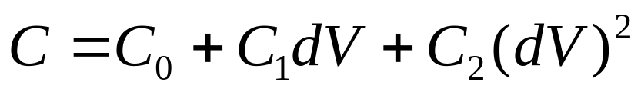
N_{DL} from C-V Curve
One DC bias can get
One C₀,C₁ by fitting
C₀³
N_{DL}
C₁
d
C₀

Slide 4
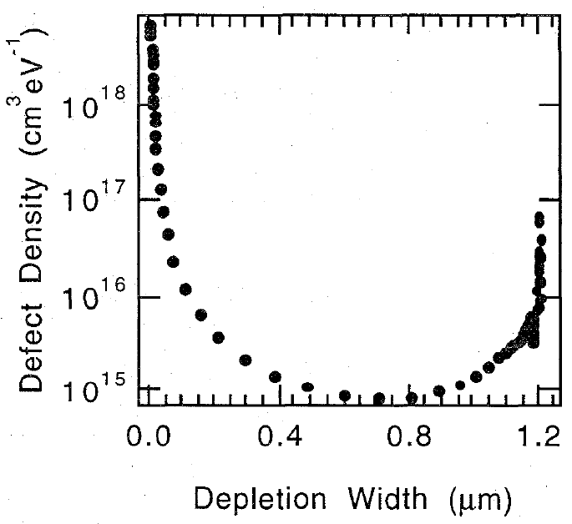
N_{DL} from C-V Curve
C₀³
N_{DL}
d
C₁
C₀

Slide 5
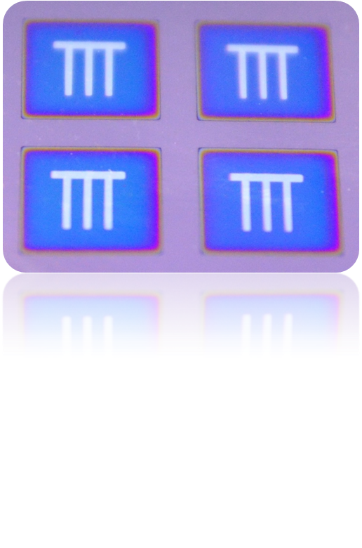
STD Sample
p-SiC
n-Si
7mm7mm
Finger Electrode (Ag) 300nm
Ag(+)
TCO Electrode (ITO) 280nm
ITO(+)
NIP a-Si:H
NIP a-Si:H film (25nm N/450nm I/25nm P)
124um or 50um不銹鋼板(-)

Slide 6
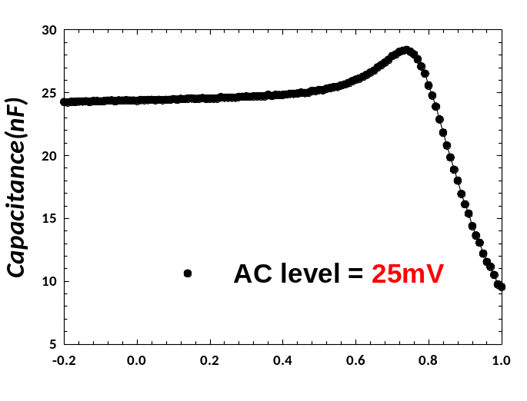
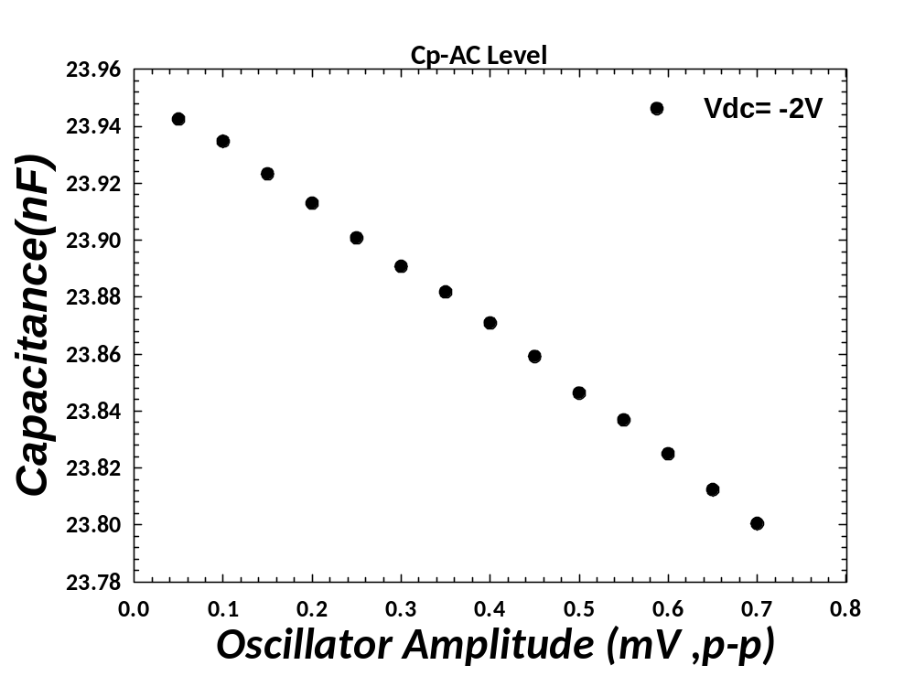
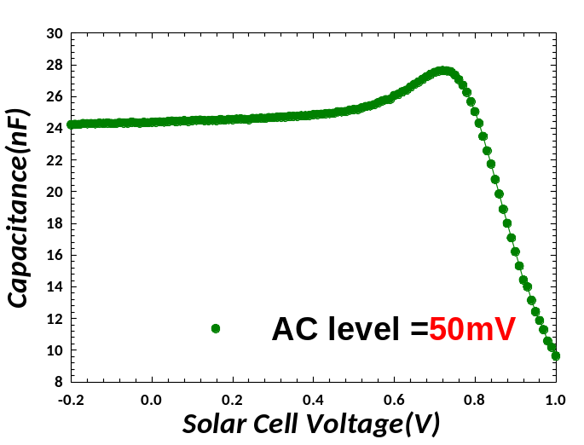
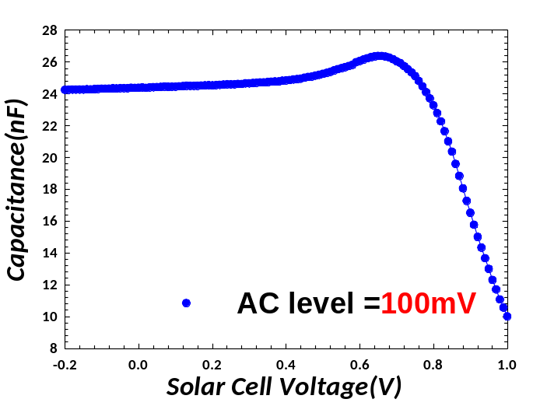
C
C₀
slope = C₁
AC level
C₀=23.957nF
C₁=-0.2192nF/V
V_{DC}
Notes:
AC 100mV
F 10K

Slide 7
N_{DL} from C-V Curve @ STD
C₀=23.957nF
C₁=-0.2192nF/V
C₀³
N_{DL}
C₁
d
C₀
Notes:
AC 100mV
F 10K

Slide 8
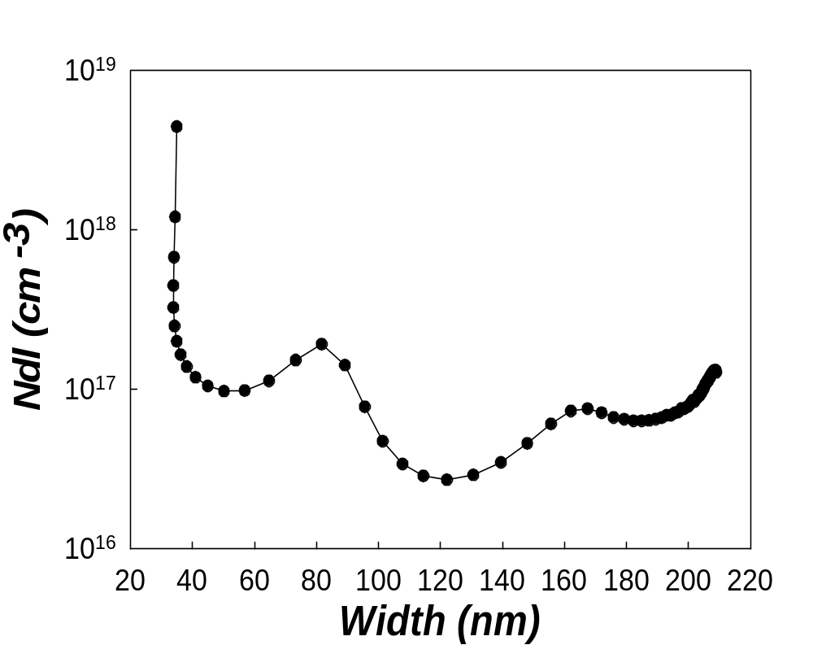
N_{DL} from C-V Curve @ STD
C₀³
N_{DL}
d
C₁
C₀

Slide 10


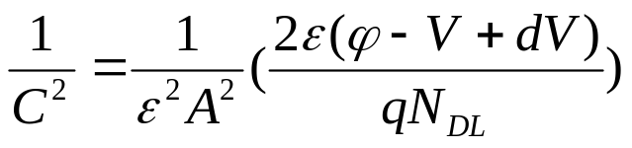
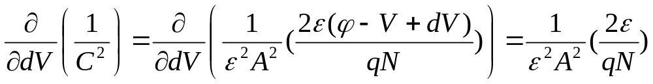
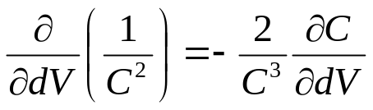
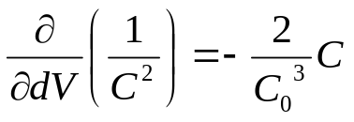
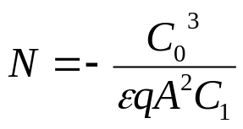
N_{dl} from C-V Curve
若
當
因
，
…………………..(1)
又
………………………………………………………………..(2)
且
，
(2)式
……………………………………………………………..(3)
(3)式帶入(1)式

